Slide 1
Financial Management and
Risk Assessment
of LendingClub Loans
Lekh Poudel

Slide 2
Lending Club
Not a bank – but like a bank.
Gives personal loans to $40,000
Connects investors for good returns.

Slide 3
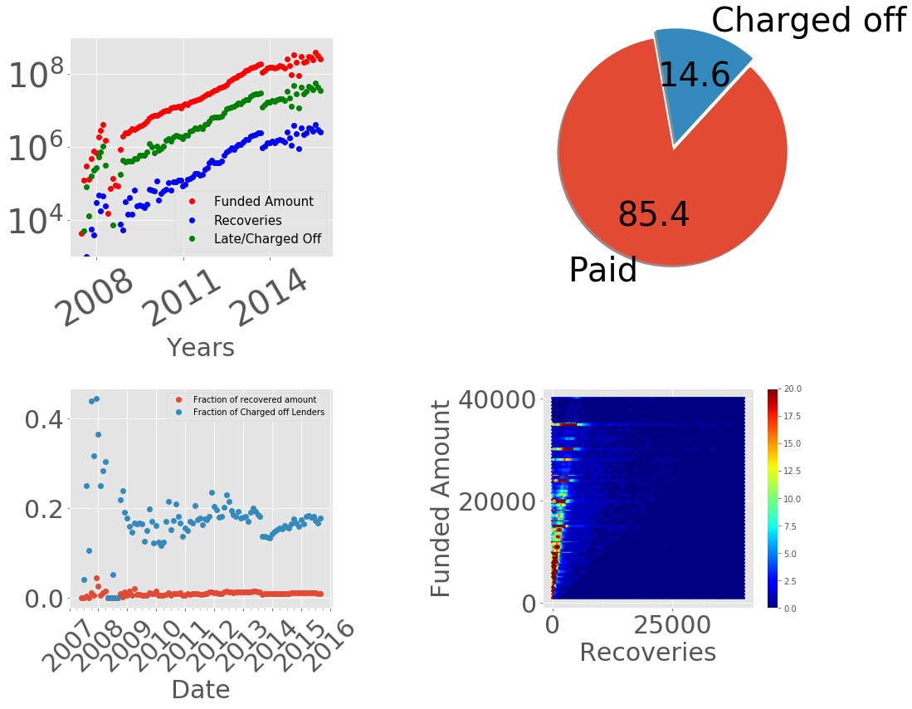
Financial History
Started in 2007
Logarithmic growth over time.
Large fraction of Late/charged-off payments.
The goal of this project is to decrease the Late/Charged-off payment in a significant amount.

Slide 4
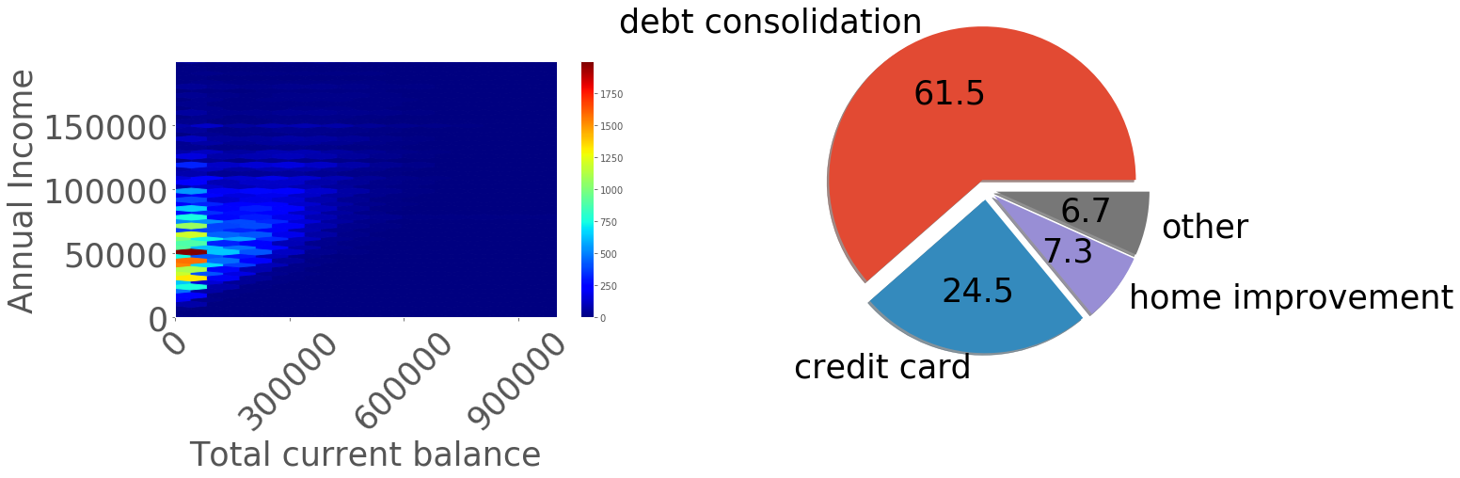
Borrowers?
Who?
People having income below $1,00,000.
Current loans less than 5 times yearly income.
Why?
Debt consolidation
Credit card payment
The major reason borrower come to the Lending club is to solve their financial problem.

Slide 5
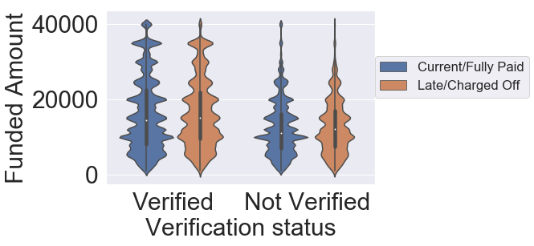
Loan Distribution
In past, the Lending club issued high loans (above $20 k) to only income verified customers. This was a smart decision.
Distribution among good and bad borrowers is similar. This also means that the average amount of loans borrowed by ‘bad’ customers is similar to that for the good customers. Ideally we want that ‘bad clients’ don’t get high amount of loans. The company expect the distribution of late/charged off customer to be centered at lower amount.
By correctly analyzing the risk, we can stop giving high loans to potentially ‘Late’ borrowers.

Slide 6
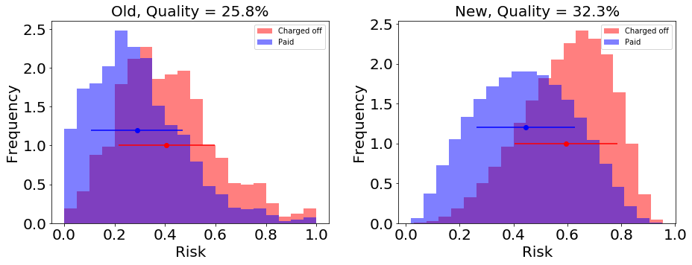
Risk Estimation
Interest of loan is proportional to the risk of borrower. Using this information, I estimated the initial risk calculated by Lending club.
The distribution of ‘good’ and ‘bad’ borrowers falls on the similar range of the estimated risk. This shows that the initial risk analysis needs a lot of improvement.
This project seeks to separate the two distribution by correcting the risk assessment methods.

Slide 7
Current Goal
Approach
Improve financial management
Identifying risky borrowers to minimize Late/charged-of payments.
Estimate returns.
Data exploration
Classification methods/Risk quantification.
Estimate return from Regression methods

Slide 8
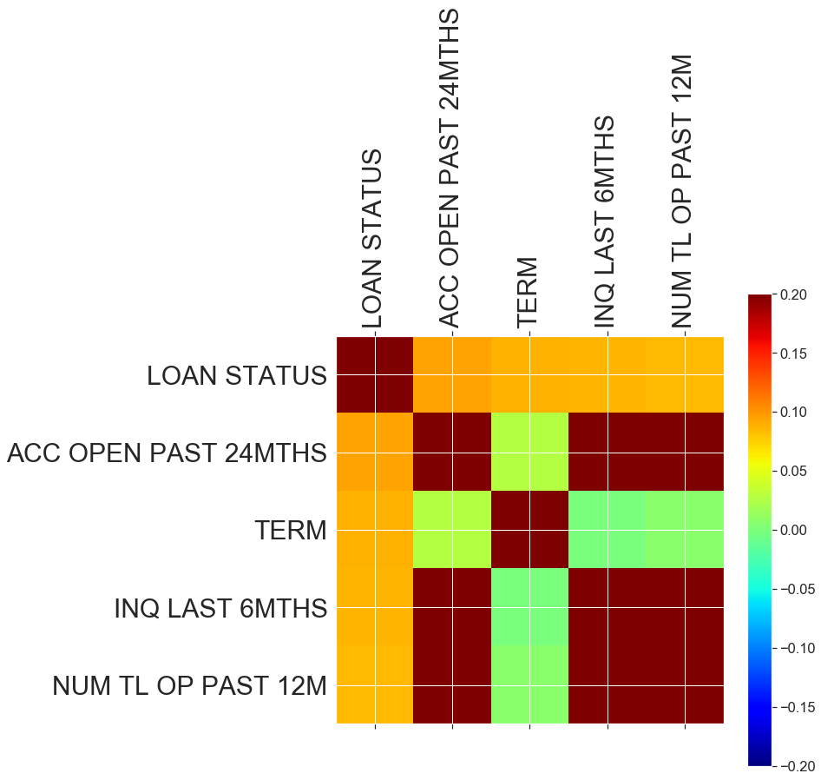
Important Features
To identify important features that determines the status of loan, I used a rough approach that calculates the correlation between the data.
Recent history is more important.

Slide 9
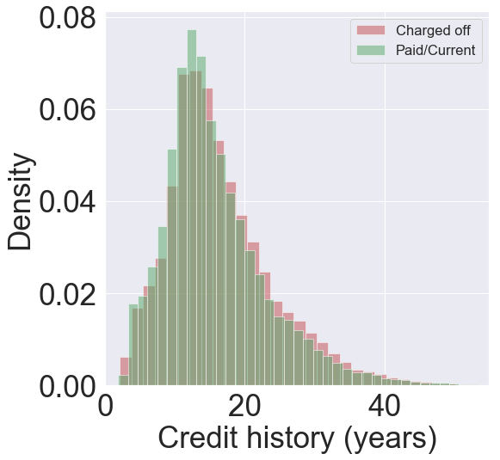
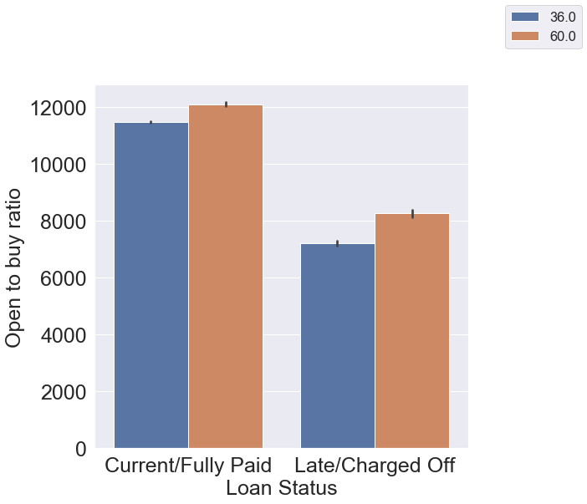
Credit history
Credit history is important.
Recent credit history is more important than long-term history.

Slide 10
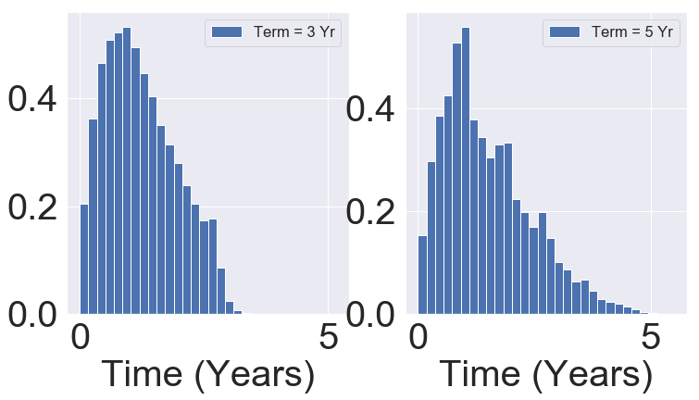
Loan Terms
Risk increases after a year of loan.
There is always a finite risk before the loan term finishes. This means 5 year loans have more risk compared to three year loans.

Slide 11
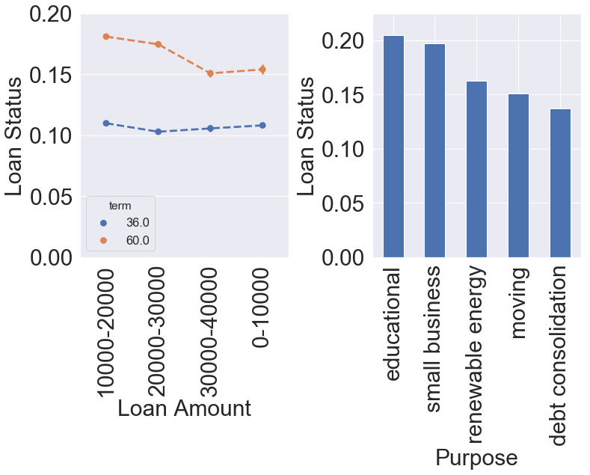
Risk
Five year loans have higher (almost double) risk compared to three year loans.
For five year term, loans between $10,000 to $30,000 have higher risk compared to other ranges.
Small business and educational loans have much higher risk compared to other categories.

Slide 12
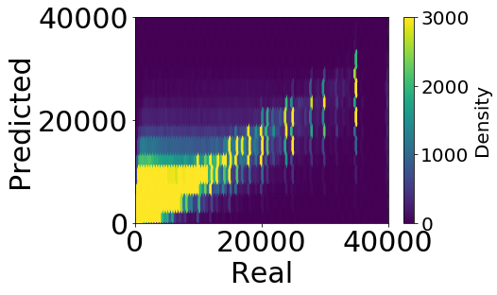
Predicting Returns
Linear Regression using scikit-learn.
Predicts how much principle amount is returned after the loan term.

Slide 13
Borrower’s Classification
I built up a statistical model using Gradient Boosting classifier for borrower’s classification.
This model classifies the borrowers with 67% accuracy.

Slide 14
Model Comparison
Compared to initial risk estimation model, our model make a better distinction between ‘good’ and ‘bad’ borrowers.
Ideally, we want to separate these two distribution. This happens only when the model is 100% accurate. The fraction of histograms that does not overlap gives the quality of the model.
Our model does much better (quality = 32.2%) compared to initial risk assessment tool (25.8%) the company was using. This improvement helps to correctly identifying the risk of $19.5 millions of the company and investors amount in the next year.

Slide 15
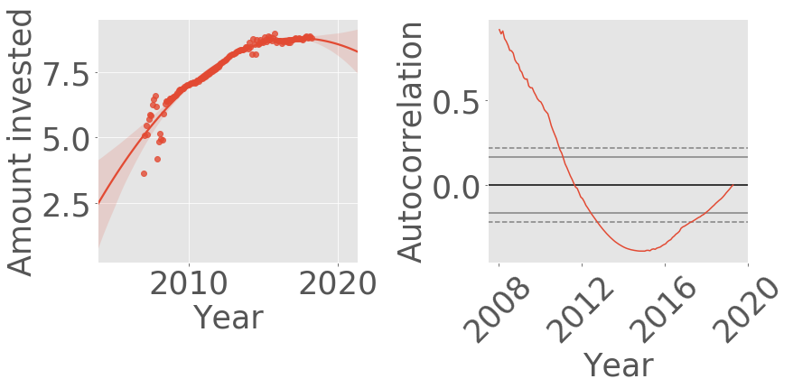
Predicting Next Year
Company makes rapid growth until 2015. This can not be captured by a linear or polynomial function.
We modelled investments in a order of log(year)³.
This model predicts that company requires three hundred million investment next year.

Slide 16
Recommendations
Our model provides a significantly better (25%) risk assessment of loans. This could save up to $19.5 million investment next year.
Shorter term should be promoted to increase loan default rate.
Loans on ‘Education’ and ‘small business’ can be discouraged.
Short term history should be given more value compared to the long term credit history.

